Slide 1
Hip joint pain taping

Slide 2
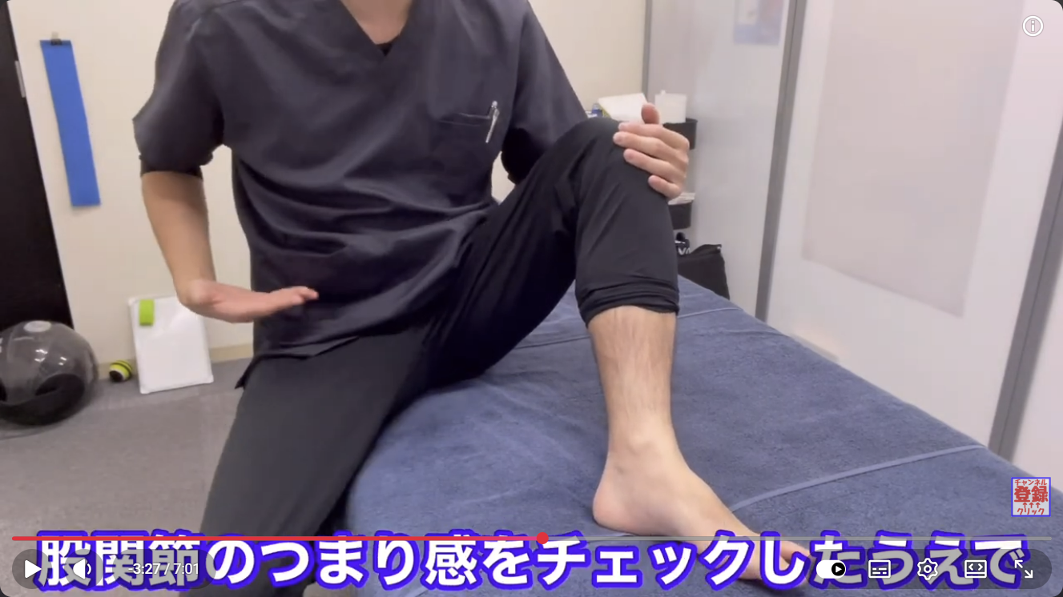
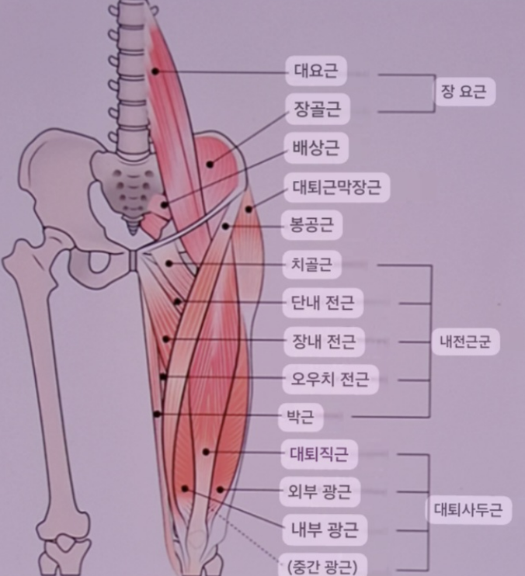

Hip joint ROM-Active test

Slide 3
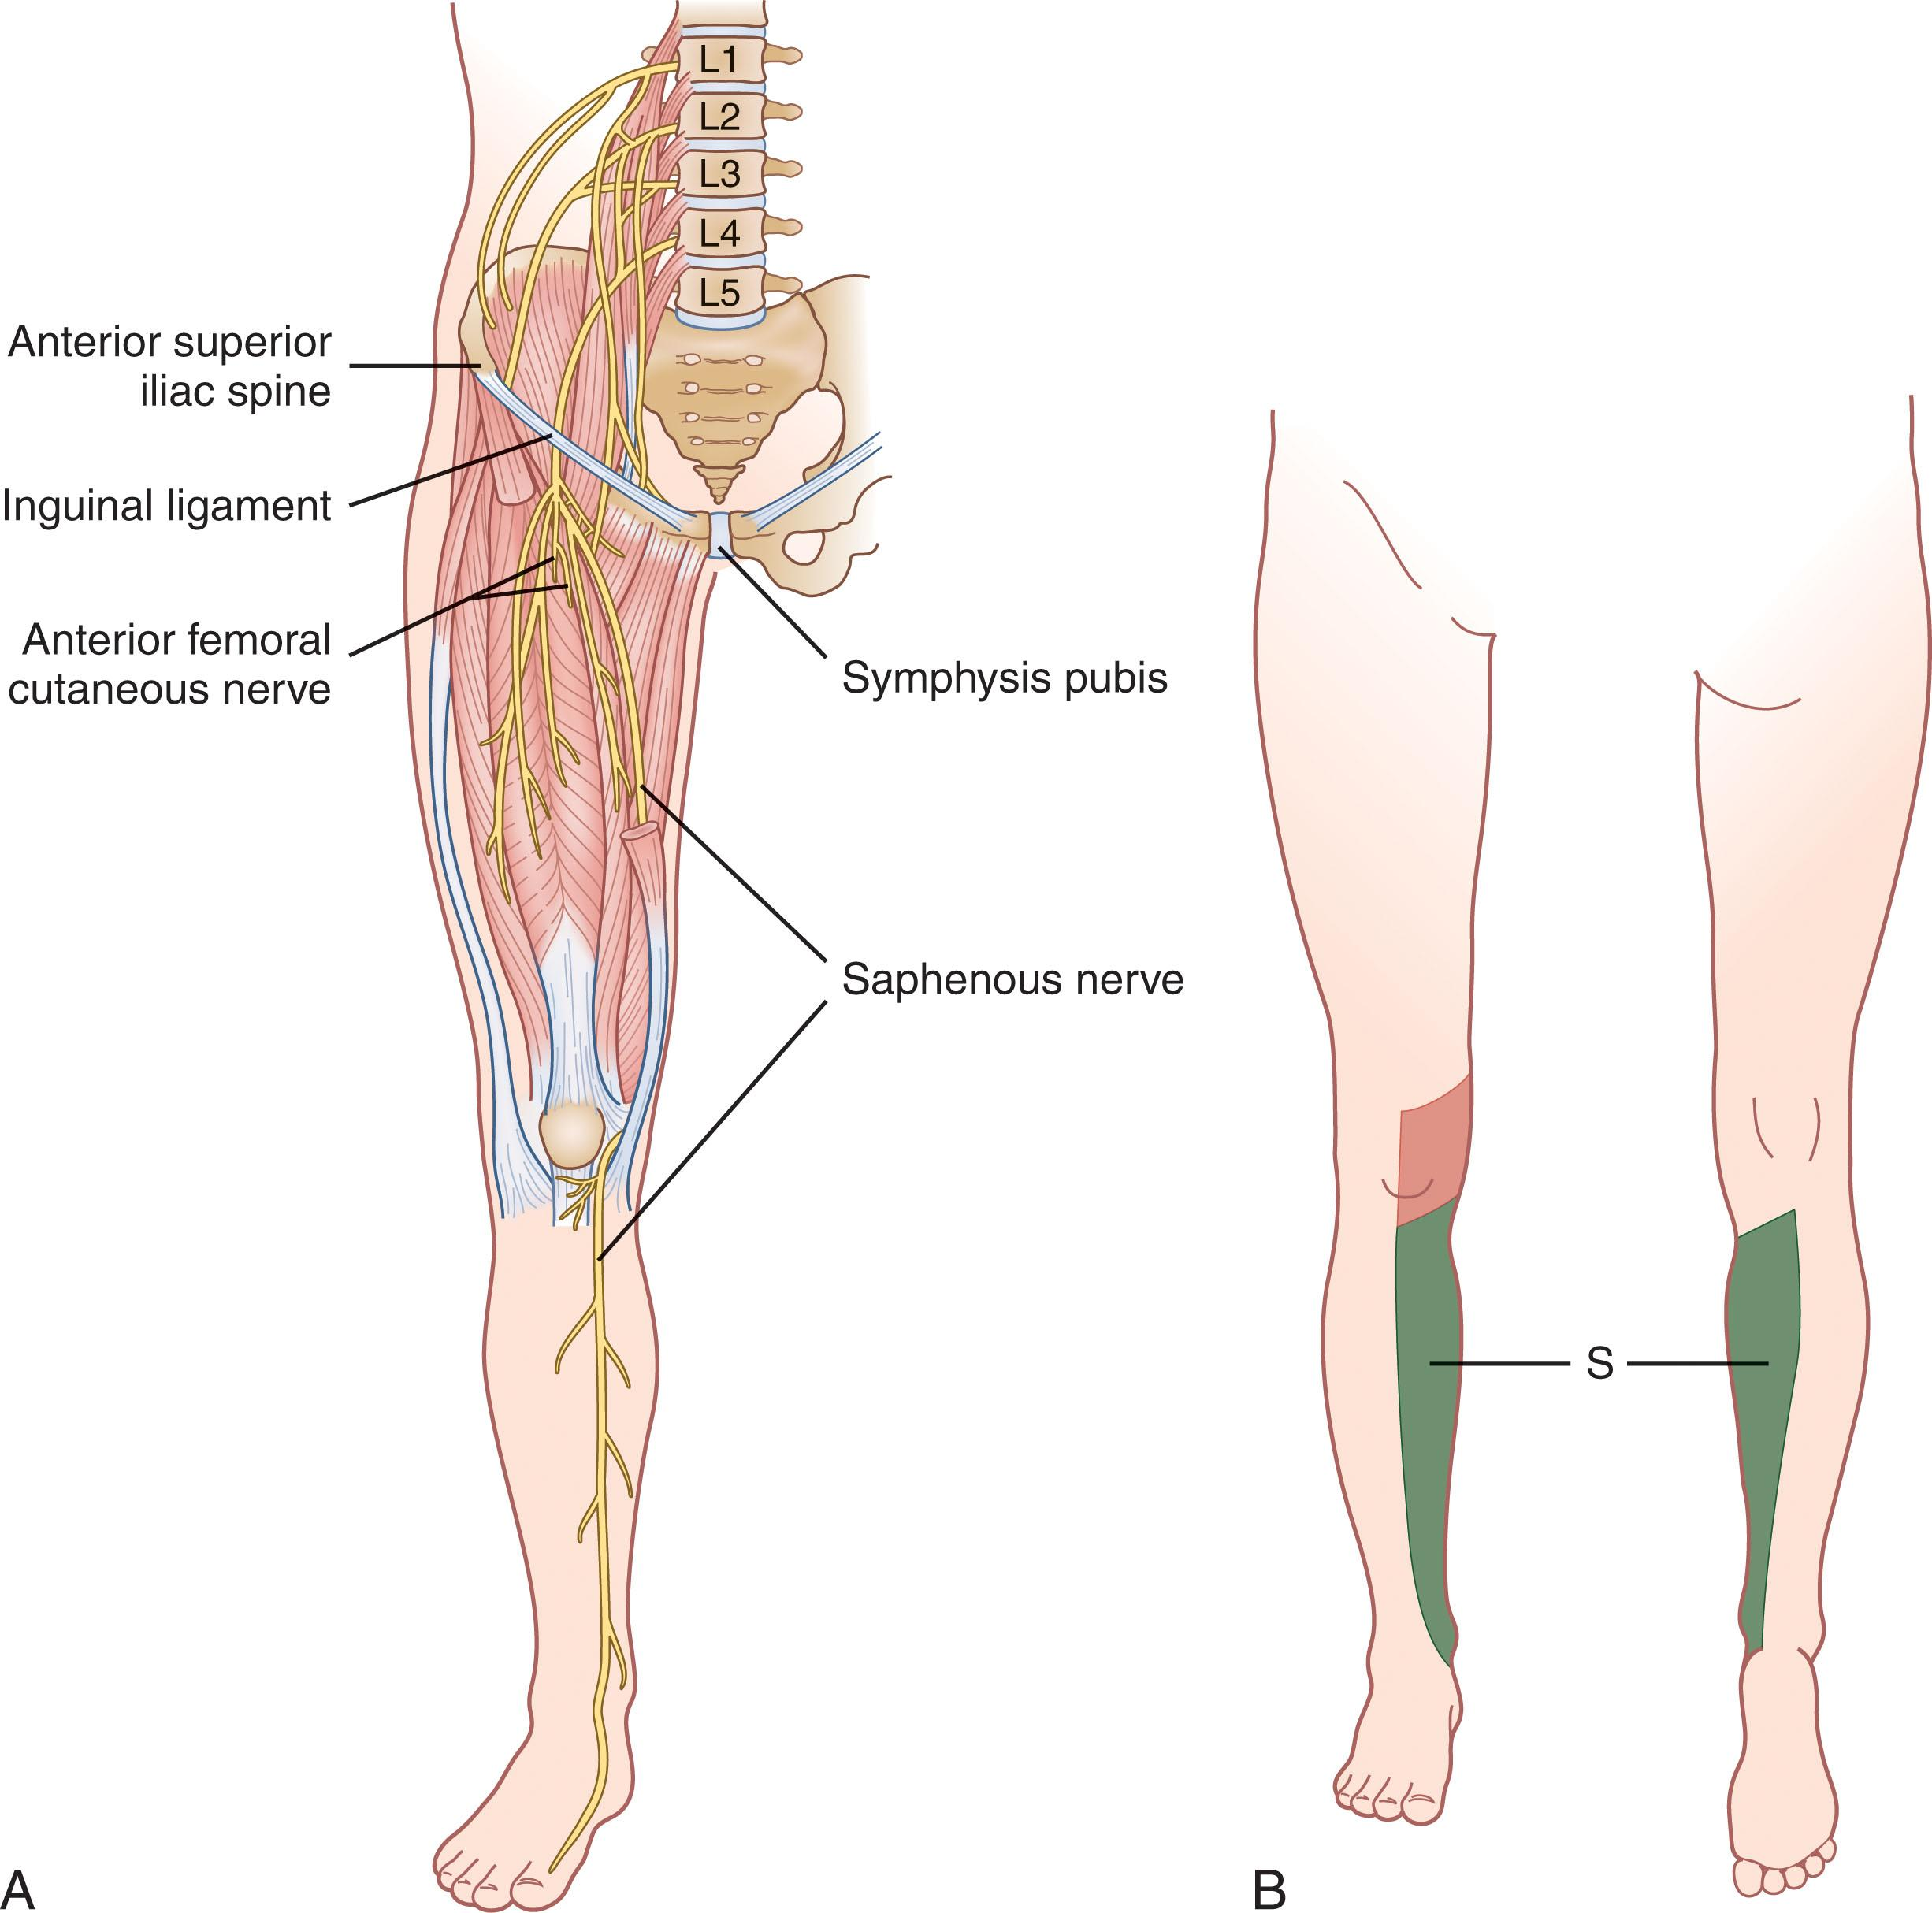
Femoral N~Saphenous N

Slide 4
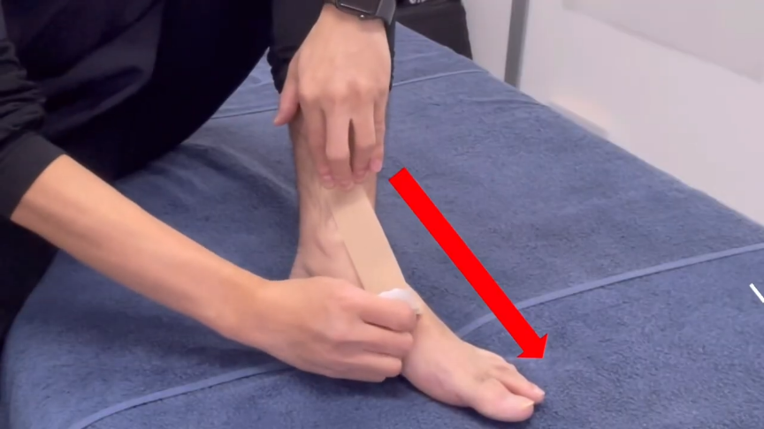
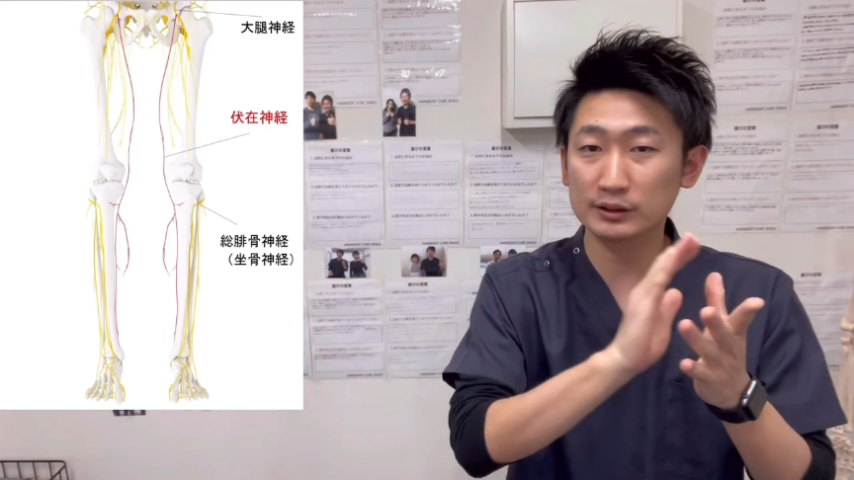

Slide 5
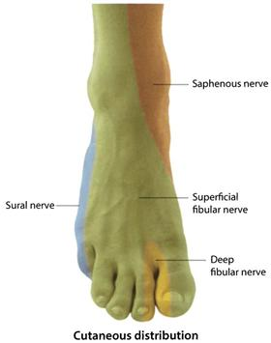
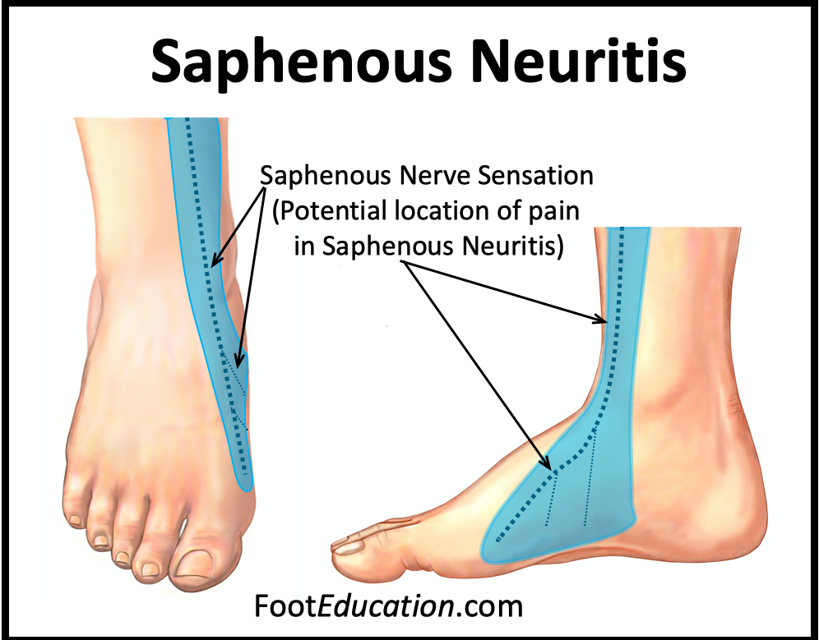
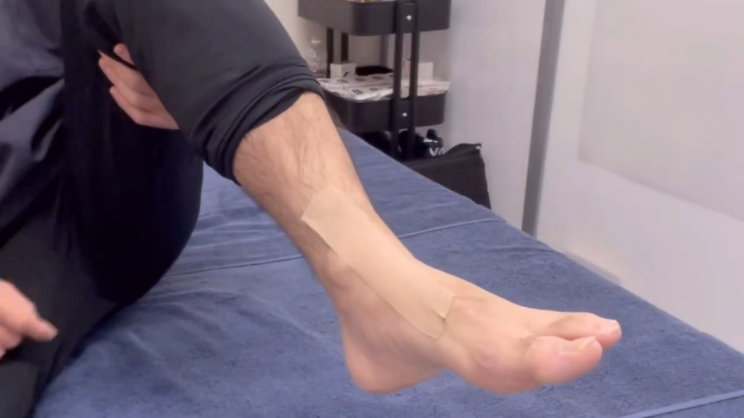
Femoral nerve-Saphenous nerve
Nerve course & pain distribution of saphenous neuritis
Cutaneous distribution of the saphenous nerve in the ankle and foot

